Slide 1


The Trans Project
Presented BY:- Tejas Deshmukh.
Project Guide:-
Prof. Nida Parkar.

Slide 2
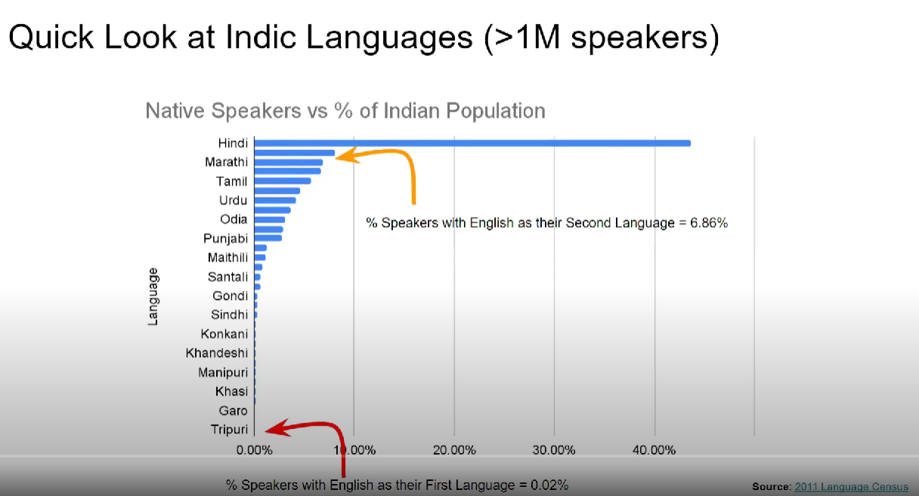

Slide 3
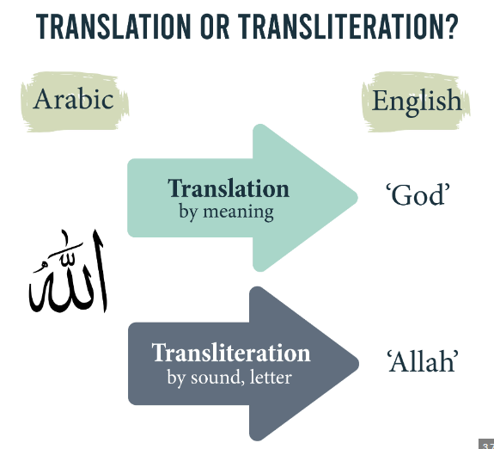
TRANSLITERATION

Slide 4
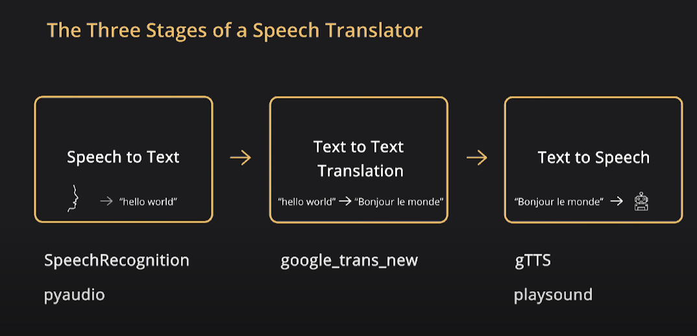
Speech translation

